Slide 1
SAS® Training
Based on Learning SAS by Example: A Programmer’s Guide
2. Introduction to SAS

Slide 2
Topics covered…
SAS libraries
Reading data from external files
txt and csv
Filename statement
Datalines
Reading SAS Log, Checking Log

Slide 3
SAS libraries

Slide 4
SAS libraries
LIBNAME statement assigns a libref
Libref (short for “Library Reference”) is an alias or nickname for a directory or folder for SAS datasets

Slide 5
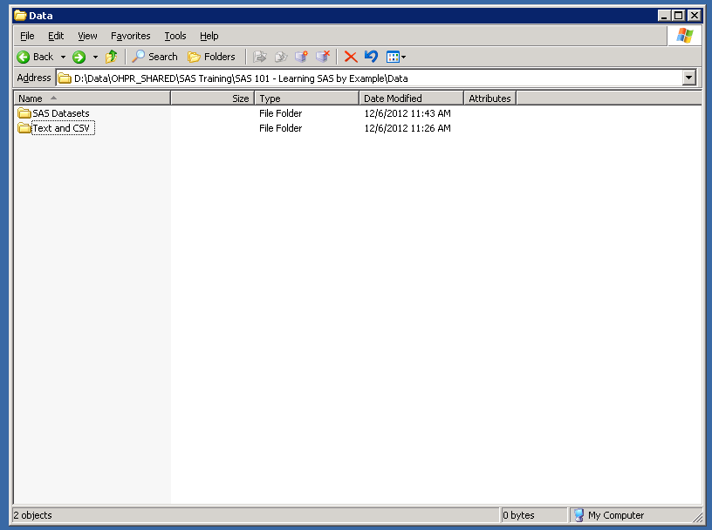
Would assign libref using LIBNAME statement
SAS Datasets:
Permanent location of all SAS Datasets
Text and CSV:
Text and CSV data files used to create the SAS Datasets

Slide 6
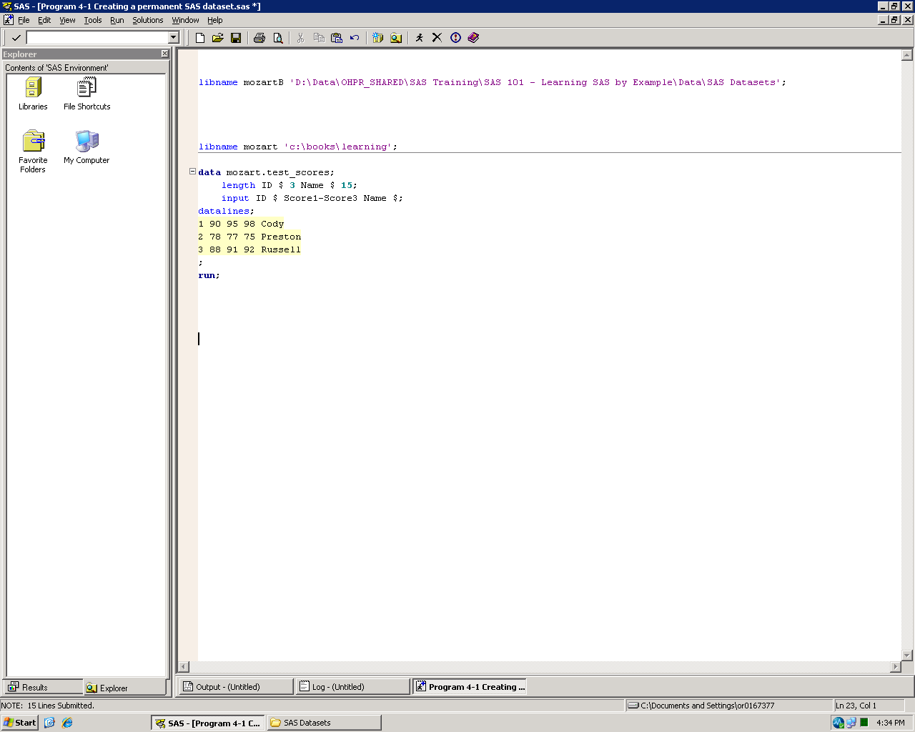
SAS libraries
LIBNAME statement:
Assigns a libref
Libref is an alias for a directory or folder where you store permanent SAS datasets
Libref can be anything you choose
Libref only exists for current SAS session

Slide 7
SAS libraries
LIBNAME statement assigns a libref
Libref (short for “Library Reference”) is an alias or nickname for a directory or folder for SAS datasets
Dataset references contain two parts:
libref
dataset-name
Looks like: libref.dataset-name
If libref is blank, the default is the Work library

Slide 8
SAS libraries
Dataset reference:
Consists of two parts –
Libref.dataset-name
mozart.test_scores is short for c:\books\learning\test_scores
Default is Work

Slide 9
SAS work library
Work is a temporary library
SAS datasets created in Work only exist during SAS session
Once SAS session ends, datasets are erased
Do not need to assign a libref for Work or specify it in dataset references
data Test_Scores; is the same as data work.Test_Scores;

Slide 10
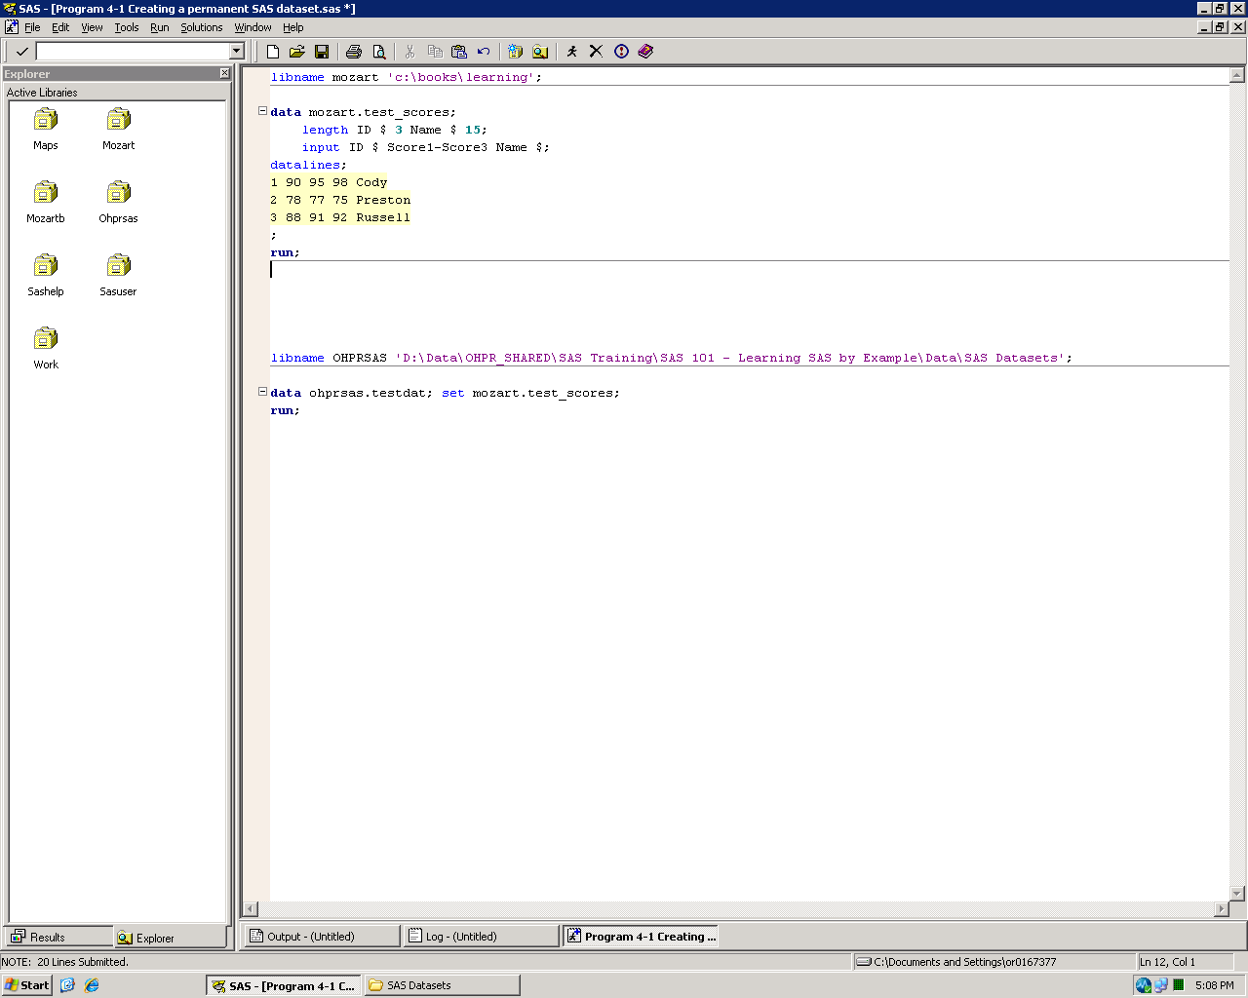
SAS libraries
LIBNAME statement:
Assigns a libref
Use the libref for saving data and for retrieving data

Slide 11
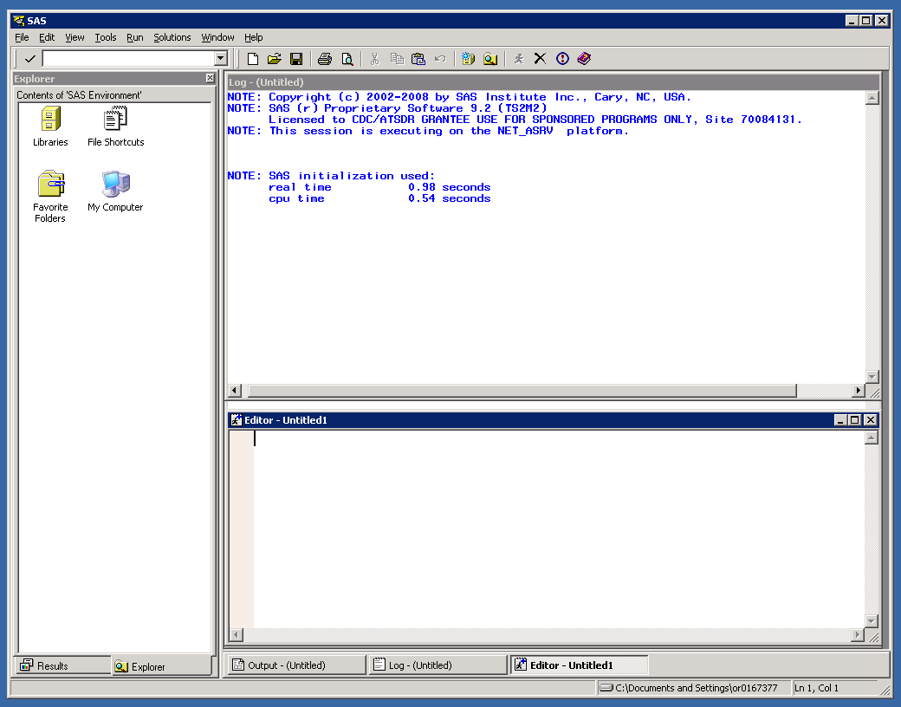
Explorer Window:
See libraries and SAS datasets

Slide 12
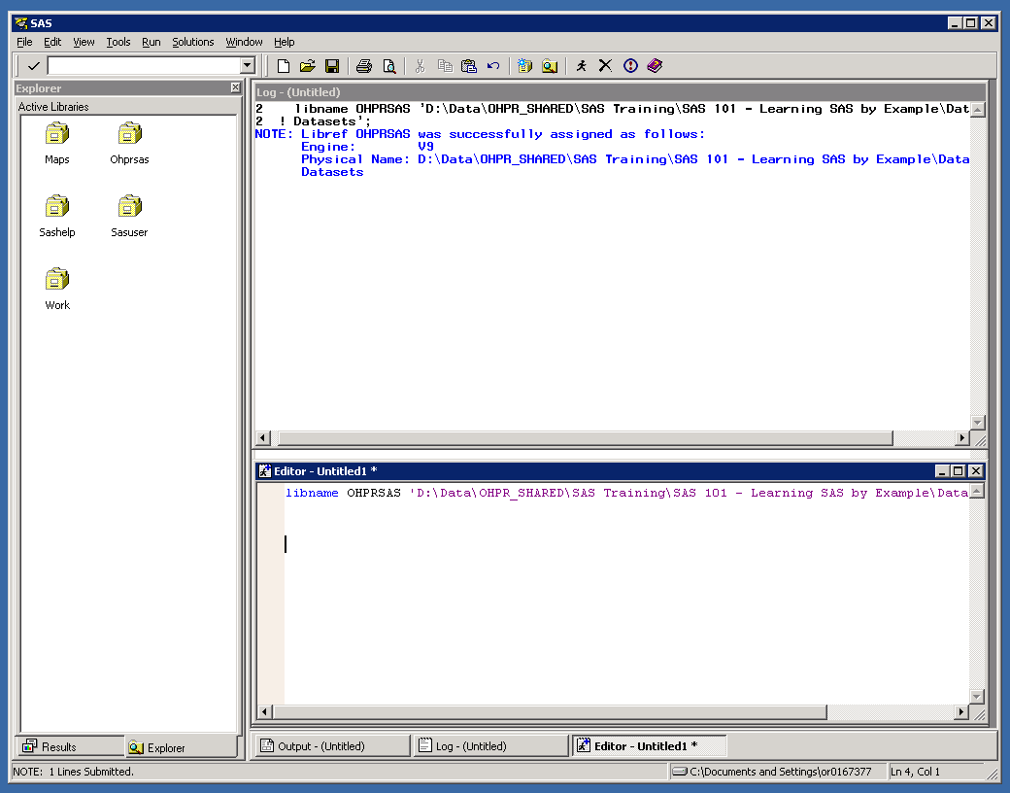
Active Libraries:
Double click on a library to see the datasets in it

Slide 13
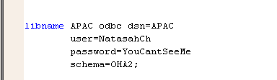
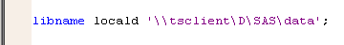
LIBNAME examples
Oops!
Your password is showing!

Slide 14
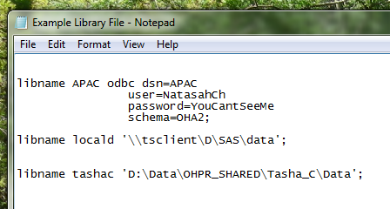
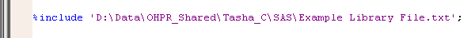
LIBNAME trick
Save your commonly used and/or passworded LIBNAME statements in a text file (using Notepad)
Use a %include statement to reference the text file at the beginning of every SAS program
SAS will include the code in the text file as if it were part of your program.

Slide 15
Reading External Data

Slide 16
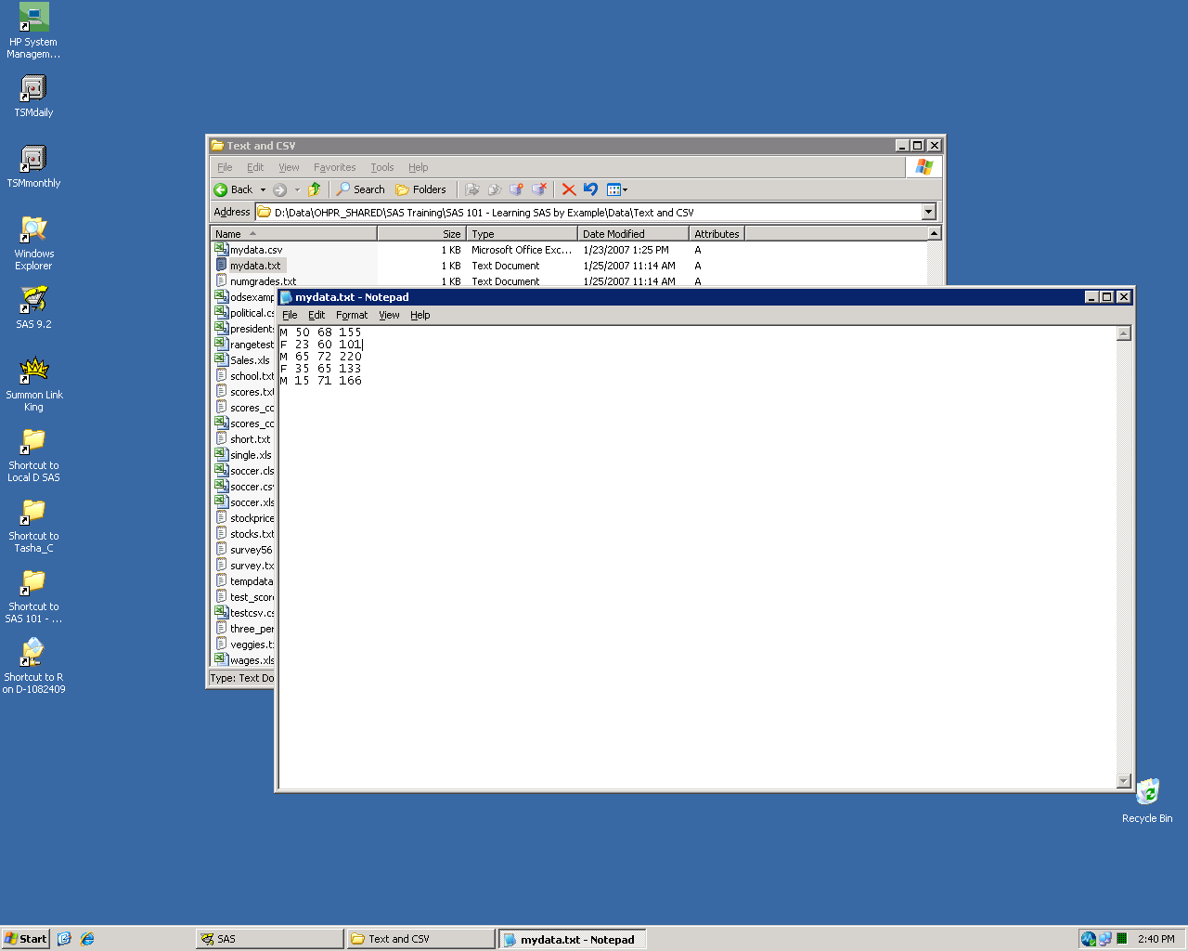
Reading data from a text file
Four variables: Gender, Age, Height (in inches), Weight (in pounds)
Variables separated by blanks

Slide 17
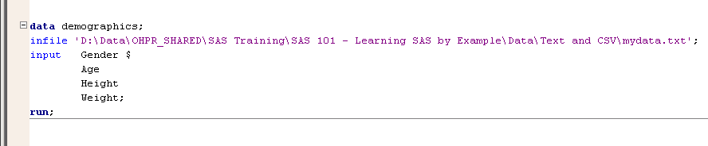
Reading data from a text file
INFILE – where to find the data
INPUT – variable names to associate with each data value
($ indicates character variable. Otherwise numeric.)

Slide 18
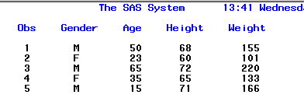
Reading data from a text file
Results of PROC Print of “Demographics”
Obs – short for “observation” (part of PROC Print output)
Numbers observations from 1 to N

Slide 19
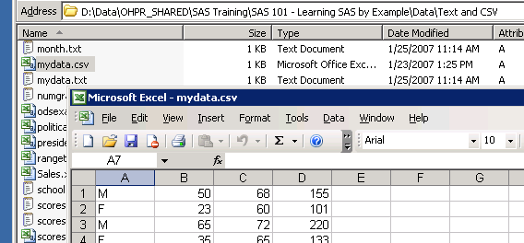
Reading data from a csv file
Four variables: Gender, Age, Height (in inches), Weight (in pounds)
Variables separated by commas

Slide 20
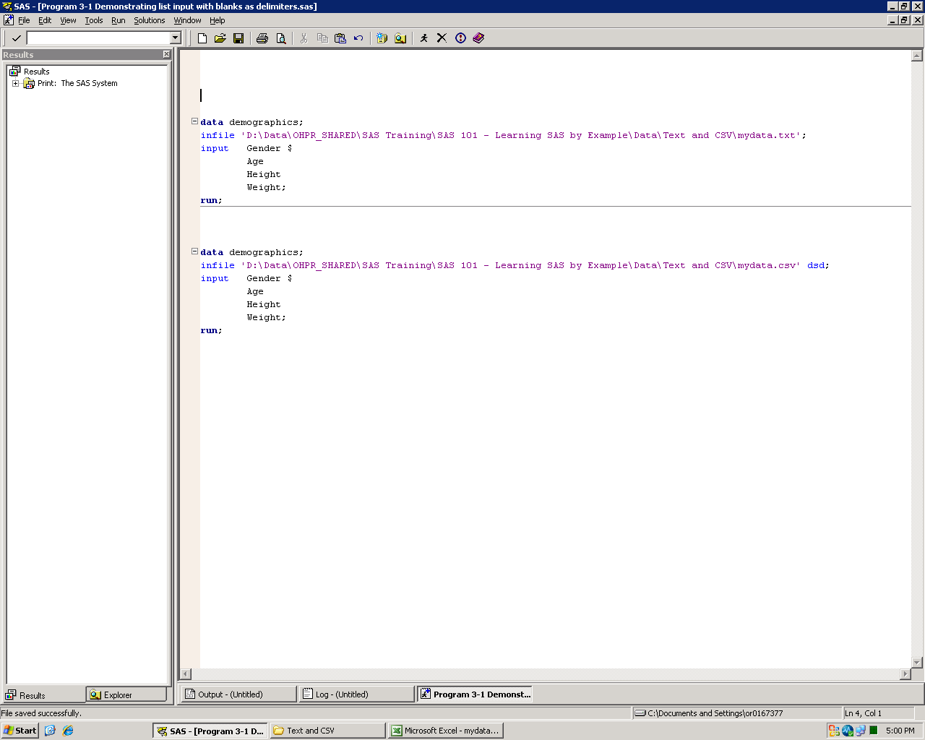
Reading data from a csv file
dsd option (delimiter-sensitive data):
Changes default delimiter from blank to comma
If two delimiters in a row, assumes missing value between
Quotes stripped from character values

Slide 21
Reading data from a csv file
Results of PROC Print of “Demographics”
SAS data results are the same

Slide 22
Other delimiters
Use the dlm= (or delimiter=) option to specify data delimiters other than blanks or commas
Example: infile 'D:\Data\mydata.txt' dlm=':';
Can use dsd and dlm= options together
Performs all functions of dsd, but overrides default delimiter

Slide 23
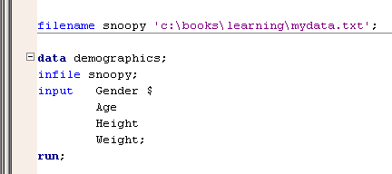
Filename
FILENAME statement assigns a fileref
Fileref (short for “File Reference”) is an alias or nickname for an external file

Slide 24
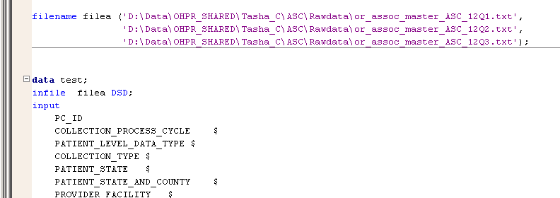
Filename
Useful when you need to read two or more files with same format (such as quarterly data)

Slide 25
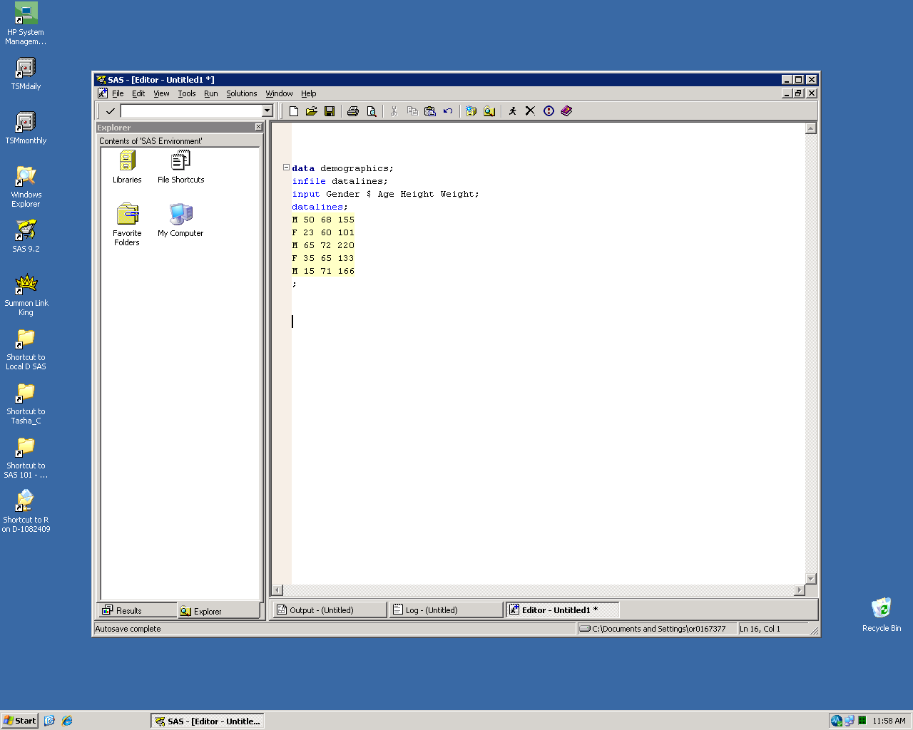
Datalines
Allows dataset to be created within SAS program
Can be useful for creating a quick set of test data
Use either datalines or cards options
Follow with semi-colon after last line of data

Slide 26
Log Check

Slide 27
Log Check
Check that the log file datetime is the same as the data set or output datetime.
Check that the program datetime is earlier than the log file datetime.
Use %put to write message to the log that help reviewing the log.

Slide 28
Log Check contd…
Programmer should check SAS log for, at the very least, messages that start with the following
keywords:
ERROR
WARNING
FATAL
Apparent symbolic reference
w\.d
Execution terminated by an ABORT
Expecting a
File is in use
Invalid
Data too long for column
Out of memory
insufficient memory
Open code statement recursion
unclosed DO block
Undetermined
Unrecognized keyword
Unrecoverable

Slide 29
Log Check contd…
In addition to keywords discussed in earlier slide, please check for occurrence of following:
INFO: Character
INFO: The variable
NOTE: At least
NOTE: Character
NOTE: Division
NOTE: Mathematical
NOTE: Merge
NOTE: Missing
NOTE: NOSPOOL
NOTE: Numeric
NOTE: Variable
NOTE: Repeats of
NOTE: Uninitialized

Slide 30

Examples: log Check
Errors
If you get an error message in your program, you will know it. Error messages get your attention because SAS will not run a job with one of these bugs. Error messages are not quiet, discrete, or subtle; they are the loud, rabble-rousers of SAS messages. This message, for example
This message tells you that SAS could not find any data to read with the INPUT statement.
This error occurs when you are attempting to format a character variable with a numeric format.

Slide 31

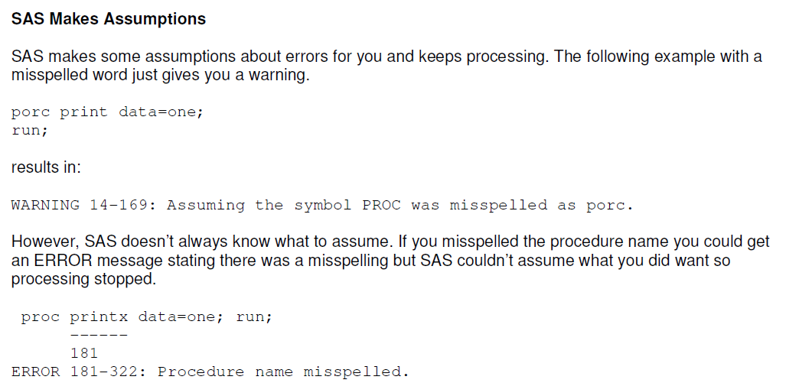
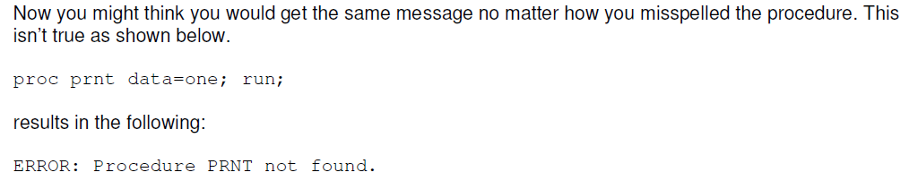
Errors

Slide 32
Warnings
Warnings are less dire than errors. SAS prints warnings in your log and then goes ahead and runs the job anyway. Many people, including some professional programmers, try to ignore warnings. Don’t you be one of them. Sometimes the situations that result in warnings are indeed harmless; other times they indicate grave problems which, if unresolved, will render your results worthless. You should check all warnings to see if they are harmless or hazardous
This warning alerts you that different lengths have been specified for a variable. This can be helpful if you were not aware this occurred; also it prevents data values being truncated.

Slide 33
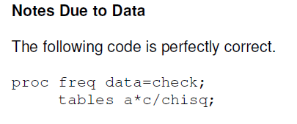
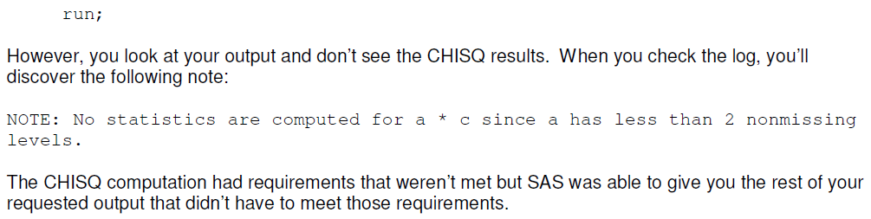
Notes
Notes are the most innocuous messages that SAS writes in your SAS log. They simply inform you of the status of your program. Notes contain information such as the number of records input from an external file, or the number of observations written in a SAS data set. Don’t be fooled by demure little notes; they are a critically important way of catching errors.

Slide 34

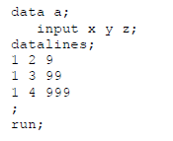
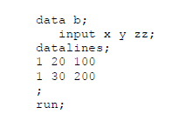
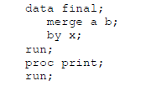
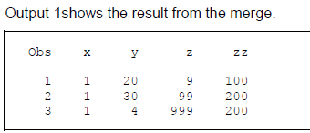
Note Contd..
Refer to attached paper

